Slide 1
Chloe Umbers
How can children thrive in the Primary School Setting?

Slide 2
Overview:
Inclusive Education – What is it and what does it look like in a classroom setting?
Prep Classroom Environment
Transitioning to School
We’re a team

Slide 3
Inclusive Education
Consistent with the United Nations (UN) Convention on the Rights of the Child, inclusive practice in early childhood education and care ensures that every child has access to education ‘irrespective of ... race, colour, sex, language, religion, political or other opinion, national, ethnic or social origin, property, disability, birth or other status’.
UNICEF (1990)

Slide 4
What does including someone mean?
‘Saying would you like to come and play with me?’– John
‘Being nice to someone’ – Michael
‘Sharing our toys with everyone’ – Elizabeth
‘It doesn’t even matter if someone is different they are just the same on the inside like our hearts and brains and stuff’ - Jo
‘Letting someone be the boss even when you really want to be’– Lilly
*All names are pseudonyms for the purpose of this presentation
Notes:
5 year olds are the most forgiving humans on the planet and are so open to difference and inclusion.
If a child has difficulties or different needs, I teach them the words to use when they are curious and then they accept. For example I often hear students helping others saying ‘what tool do you need to get yourself back and ready to learn?”

Slide 5
What are some of the challenges
I might see in the classroom?
Low muscle tone- fine and gross motor skills
Speech delays and expressive language disorders
Concentration/attention disorders
Sensory processing challenges
Delayed motor development
Auditory processing
Mental wellbeing concerns including anxiety and depression
Notes:
Spectrum and may present very differently in each child

Slide 6
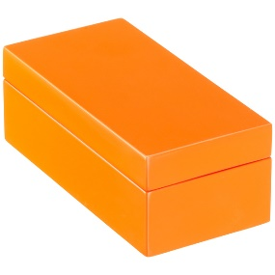
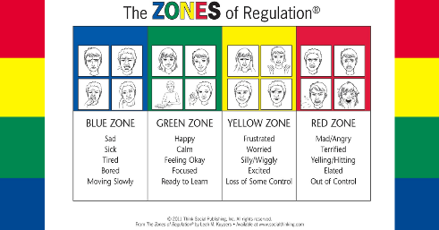
Environment
It is imperative that the classroom environment is responsive to the needs of the children as well as being an inviting aesthetic space that ignites a passion for learning
- Not only physical but the ‘vibe’
Calm
Quiet Spaces/sensory escape
Places to stand, sit at a table, sit on the floor
Single space, partner, group
Visual Tools to assist with regulation
Notes:
Microphone/ speaker for hearing needs
Placement of seats for instruction
Wobble chairs
Chairs instead of ground

Slide 7
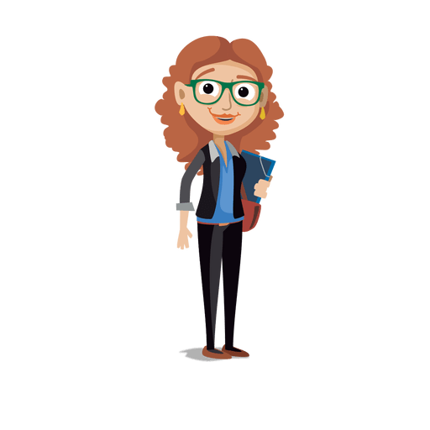
Environment for Learning
Zones of regulation assist children in naming their emotion. Once you/they have identified the emotion they are feeling, it’s important to highlight the tools to help get ‘back in the green zone’.
Are you ready to learn?
Go for a walk
Have a drink
Have a snack
Listen to music
Bounce a ball/push on a wall/do some stretches
Squish some play dough
Listen to a joke
Notes:
Are you ready to learn is asked to all children.
All children use Zones of regulation – we are all using the same language.
Having the expectation that young children can (with training) identify the emotions they are feeling and then in turn, identify the tools that help them feel ready to learn.

Slide 8
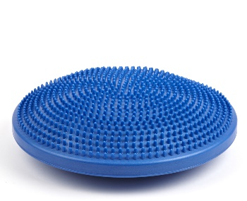
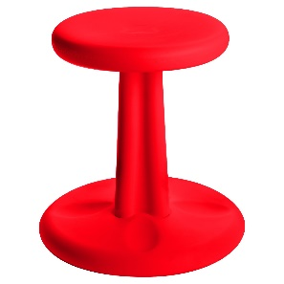
Challenges in the Classroom:
Gross and Fine motor Skills
Working closely with specialists (PE planning) families and professionals to strengthen
Concentration
Tools in the classroom (Wobble stools, cushions, fiddle toys)
Speech & Hearing difficulties
Hardware available, visuals, routines etc.
Reading & Writing
Notes:
Tools Sarah will talk about – Slant board, pencil grips, seat adjustments
Speech and hearing – As teachers we know that not all children are going to understand something the very first time you explain it. We expose children to many different ways of understanding and thinking – on multiple occasions. Purposeful and responsive planning
Work with your teachers! Three families this year after finding out I’d developed a box for a child have brought in their own boxes that their child can access when required.
Reading and writing- Prep Testing will give teachers a rough idea of where each child is at academically. It is very child friendly and there is much value in children spending some time with their teacher – finding out what they are interested in.
Early on in the year if the teacher finds each child is 6 months or more behind they will write an ILP – meet with leadership team and parents and create a plan. Tools to use- Alphabet strip -

Slide 9
Transition to School
For children and families, starting school is an exciting and often daunting milestone.
Decide where your child is going early
Do as many tours as you can until you find the right ‘fit’
Get in contact with your school teacher as soon as possible
Attend all transition sessions
Visit the school grounds
Ensure your child can use their new school equipment independently (opening lunch box, school bag, putting school clothing on and off)
Meet fellow families starting school for the first time – they will be an invaluable support in those early days!
Notes:
Social Stories, The first few days- ask what’s involved
Friendships – Teachers will work very hard on developing the classes
Don’t sweat it! Chances are there will be 20 other parents feeling the same thing as you! The teachers will ensure it all goes smoothly for your child.
Are they ready? So much out there 144,000,000 results on google.

Slide 10
Transition to School
Alphabet – talk about the most common sound each letter makes a - /a/
Count
High Frequency Words
Read every day
Notice print you see in the environment
Self Care
Build Resilience - there are lots of ‘unexpected’ things that happen in a typical school day so build the ability for children to ‘roll with it’
Encourage some independence and agency – Can they solve problems for themselves?
Ask loads of questions!
Social/Emotional Skills
Notes:
Not only read with your child but read to your child
Children need to be taught explicitly the things to do and say to make a new friend.

Slide 11
‘It Takes a Village’
African proverb that highlights the idea that it takes an entire community to raise a child.
Mum
Dad
Grandparents
Kindergarten Teachers
School Teachers
Education Support
School Principals
Speech Therapist
Psychologist
Paediatrician
Behaviour Therapist
Occupational Therapists
Physiotherapist
Child
Notes:
Early Intervention is key
Many stake holders in a child’s life – For all children to achieve success it is imperative that we all work together.
Work with your teacher – They invest so much into the kids – it’s important that you get support.

Slide 12
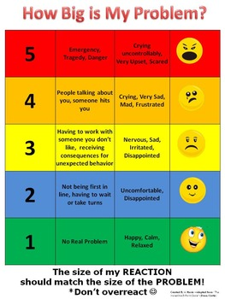
‘It Takes a Village’
Strategies Kindergarten already have in place
Zones of Regulation
Sensory Outlets
Choice “would you like to go to the writing table or the play dough table?”
Letter Visuals
Tummy Breathing
Catastrophe scale (See image)
Notes:
Set each child up for success! Why start new strategies when there are already strategies in place that WORK for the child!

Slide 13
High Expectations
• Believing that each child is capable of learning
• Communicating high expectations to children and parents
• Taking responsibility for children’s learning and
• Reflecting on teaching practice
High expectations for every child affirms that children have diverse culture, ability, learning styles, personalities and identities and that each child can experience success in their learning and wellbeing (MacNaughton, 2003; Jalongo, 2007).
Notes:
Challenge is OK. Struggling is Ok, in fact we need to struggle to learn something new. If we don’t find it hard – we already know how to do it!!
Be a team – Working so closely with Anita was the best thing for all of us ! Baylen achieved so much success in his first year of school because we worked as a team
In a study by Schiff & Tatar (2003) most children reported that significant teachers – those making a positive difference – expect them to succeed. High expectations from parents, professionals and peers are linked to self-esteem, children’s sense of agency and academic motivation. These factors in turn lead to educational success

Slide 14
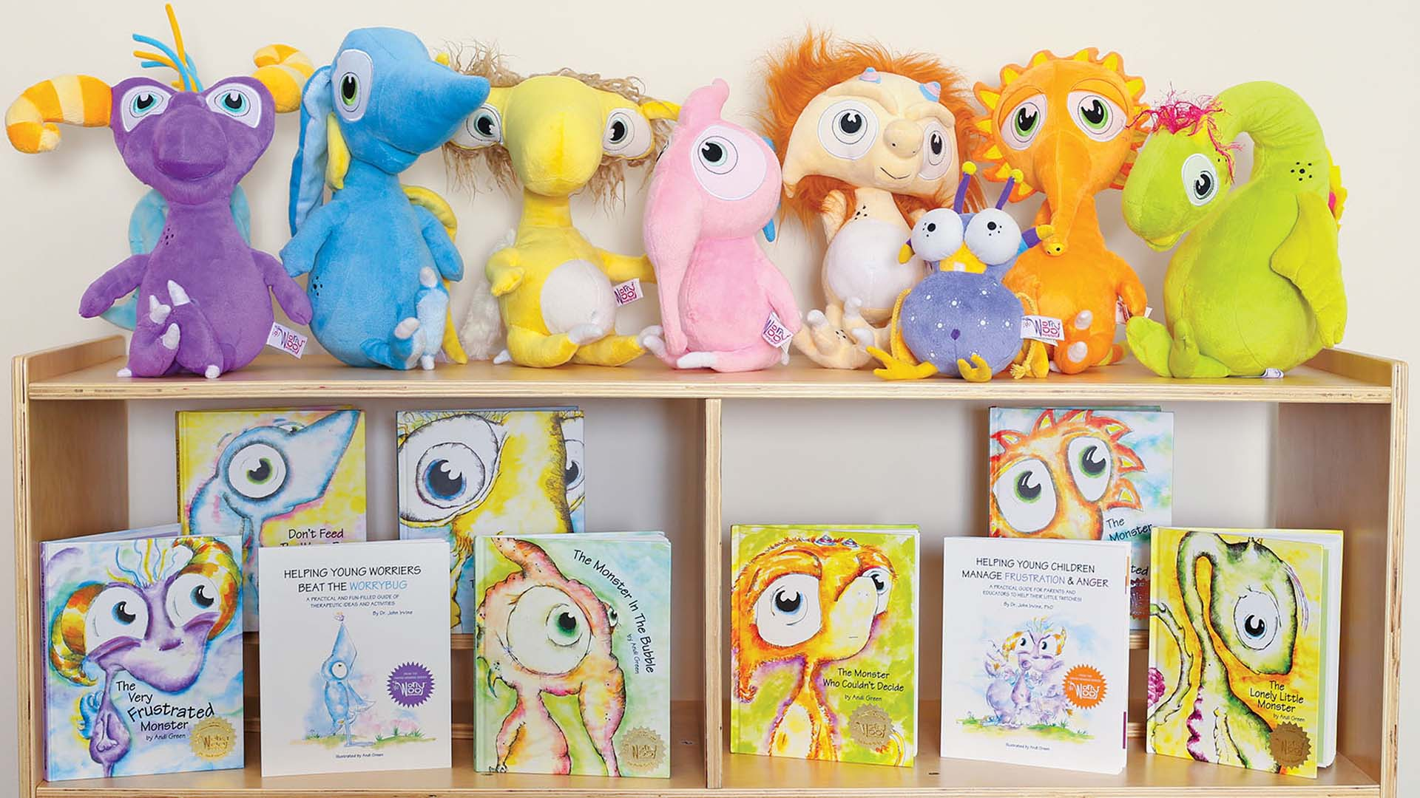
Great Resources!
Worry Woos
The Kissing Hand for Chester Raccoon
Audrey Penn
The Invisible String
Patrice Karst
Hey Warrior
Karen Young
Don’t Feed the Worry Bug
Wince the worry Monster
The Monster of Frustration
The Monster in the Bubble
The Girl who never made mistakes
Mark Pett & Gary Rubinstein
https://sensorytools.net/
- Sensory Tools Australia
http://www.worrywoos.com/children-and-anxiety.html

Slide 16
Questions

