Slide 1
Early intervention
Integrating play and therapy into everyday life

Slide 2
Sarah Munn
Occupational Therapist Director - Barefoot Therapists

Slide 3
Occupational Therapy
Assess what children do every day
Routines and activities
Independence
Community
Why are they having difficulties
What are goals for intervention
Play and Activity based

Slide 4
Early Intervention
Paediatrician
Occupational therapy
Speech pathology
Physiotherapy
Psychology
Specific programs

Slide 5
Early Signs for Intervention Early Milestones – Gross Motor
Head lag
Late to sit
Late to crawl
Walking, jumping
Clumsy and uncoordinated
Low muscle tone

Slide 6
Early Signs for Intervention Early Milestones – Fine Motor
Gross motor affects fine motor development
We work from a stable posture to use our hands
Developing coordination
Enhancing manipulation and dexterity
Early milestones include eating and pre-writing abilities

Slide 7
Signs for Intervention Milestones – Communication
Language delay
Expressive language disorder
Social skills
ASD traits – screen

Slide 8
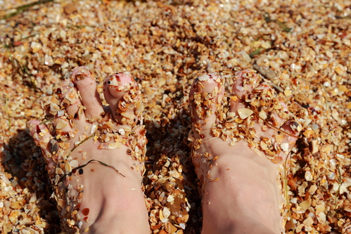
Sensory Processing
That hurts!
That’s noisy!
That’s too bright!
I need to wash my hands
I love messy play
I chew a lot
That label is scratchy
That food makes me vomit

Slide 9
Cognitive Skills
Processing skills
Intellectual capacity
Executive functioning

Slide 10
Reaching Their Potential
There has never been a better time for inclusion
Let’s challenge our own perceptions of ‘different’

Slide 11
What helps
Individual
Group
Home and kinder visits
School readiness groups
School based
Rural program
Horse therapy
Community support - Dance

Slide 12
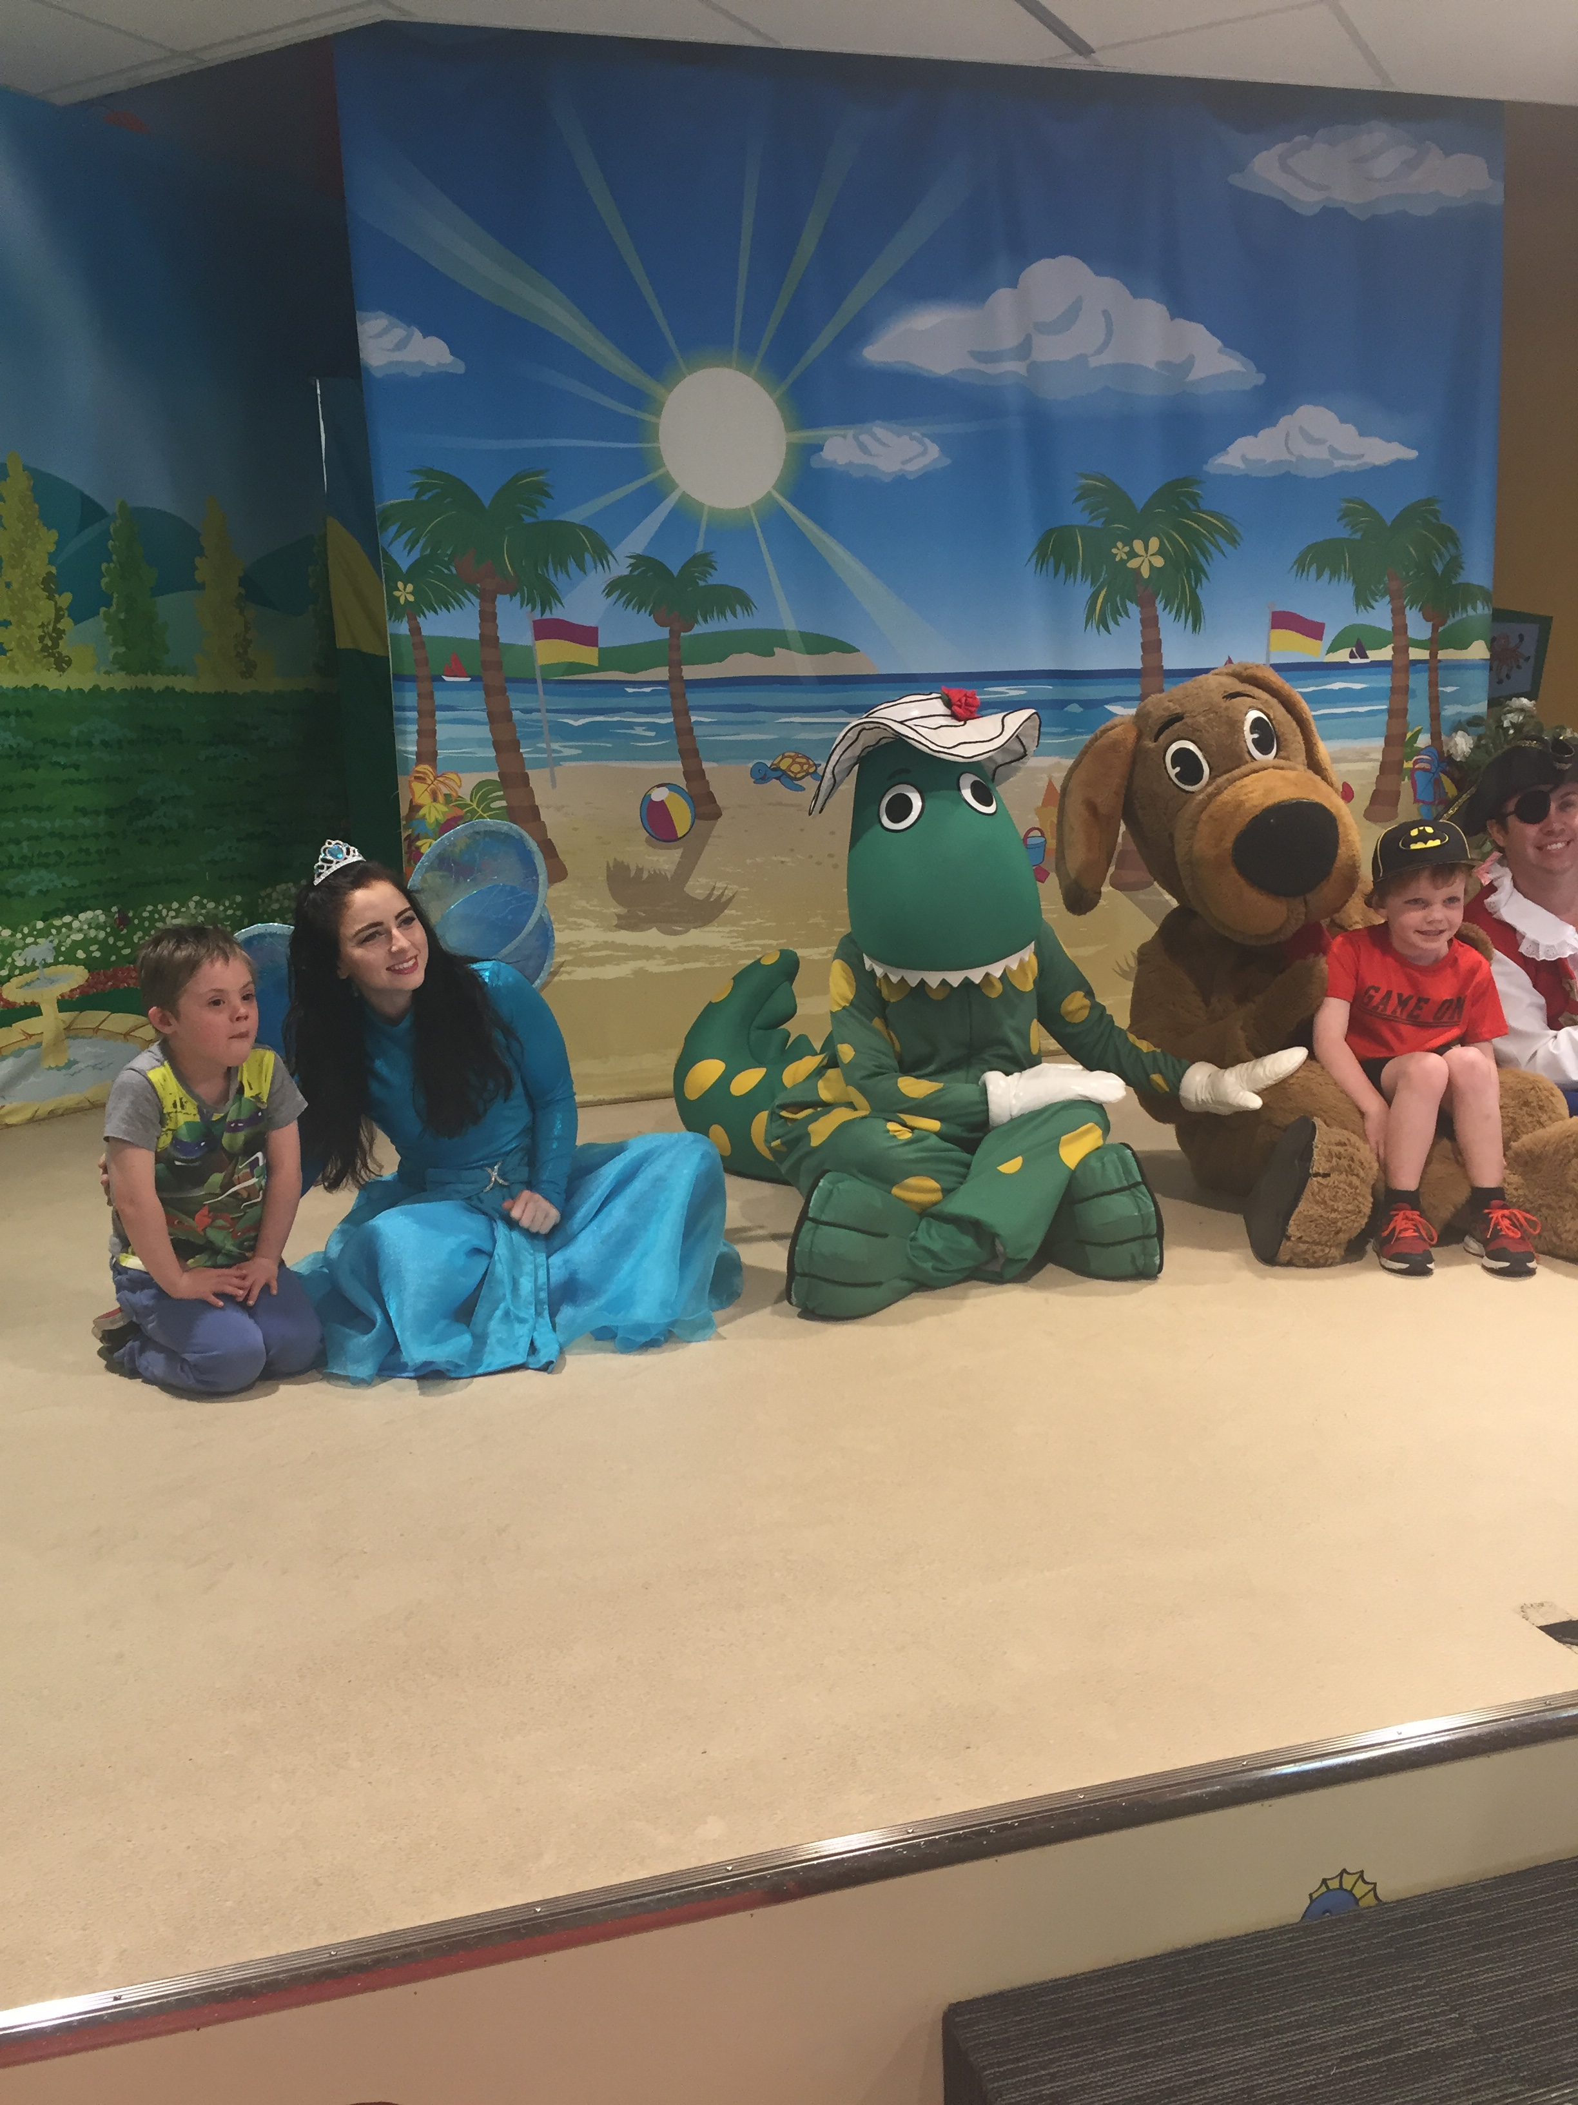
Empowerment - Put yourself in the driving seat
Developing your team
Medical
Therapy
OT
Speech
Psychology
Physio
Education
Education support
Teacher
Principal and Welfare (often AP)

Slide 13
Make it fun
Child’s motivation
Play differently
Upskill yourself
Then have FUN

Slide 14
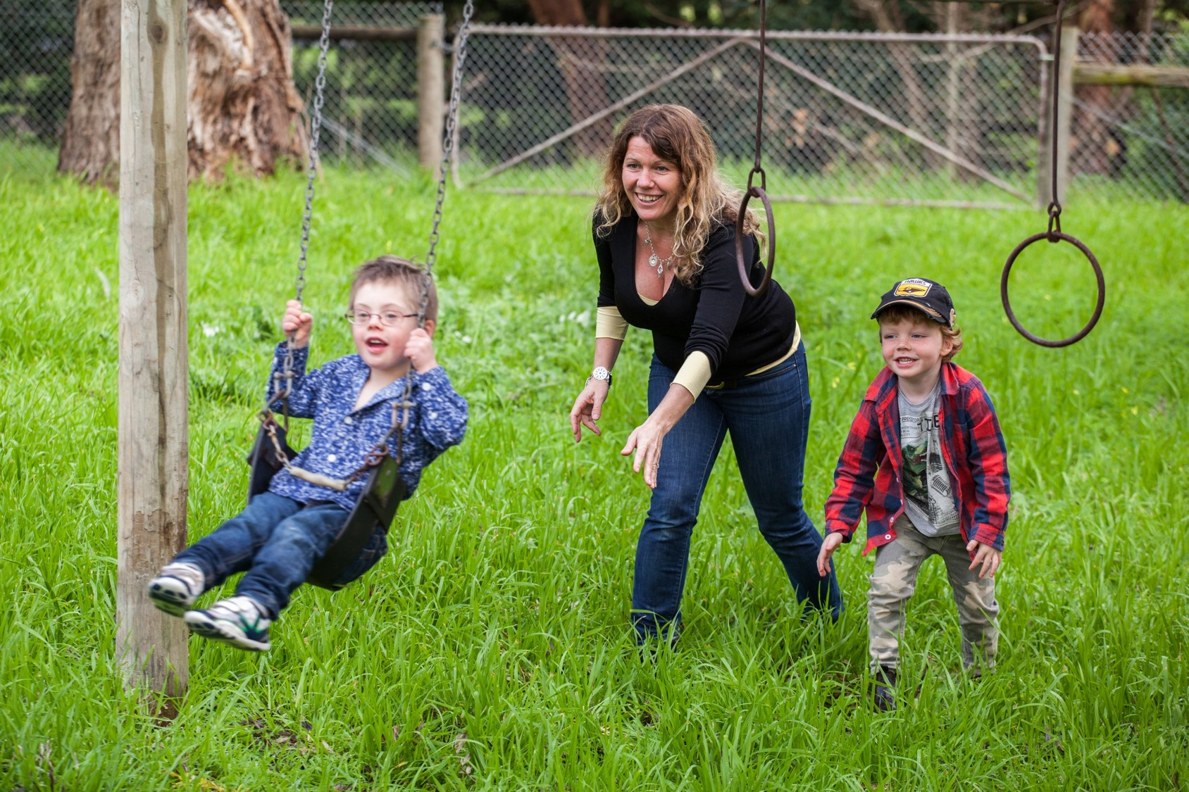
Make it fun
Its Child’s play
At home
At kinder/school
At the playground
At sports and clubs

Slide 15
Build early skills for later success

Slide 16
Thankyou
sarah@barefootot.com.au
Tel: 03 5981 1120

