Slide 1
The way forward for fertility options for men with Klinefelter Syndrome
Dr Hossam Elzeiny
MBBS FRANZCOG CREI
Medical director RSU RWH
Melbourne IVF
AXYS Information Seminar
10/11/2018

Slide 2
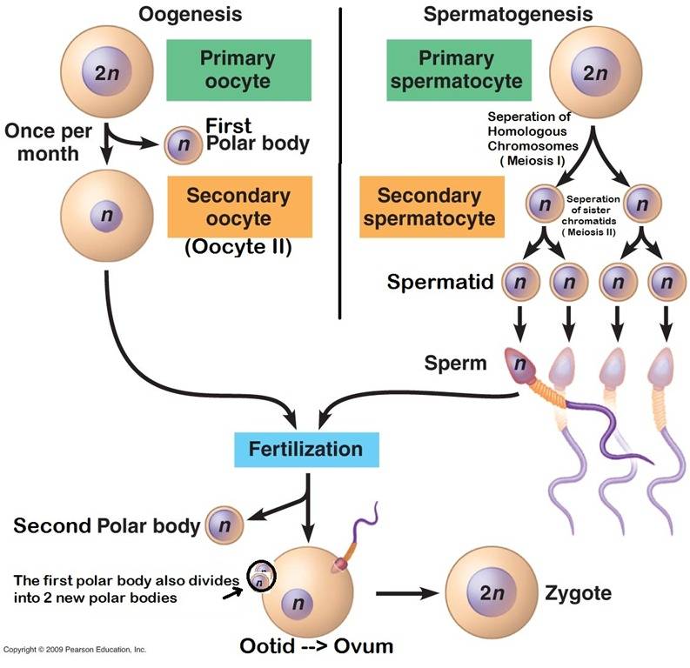
Egg and Sperm formation and interaction

Slide 3
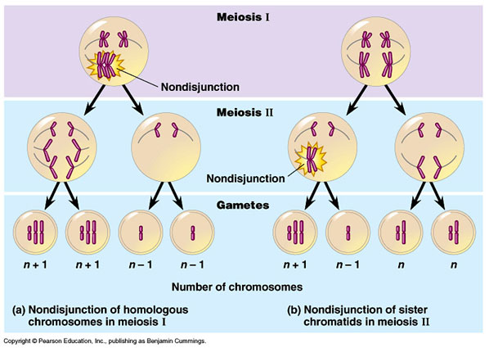
Nondisjunctions Meiosis I & II Maternal 40% & Paternal 60%

Slide 4
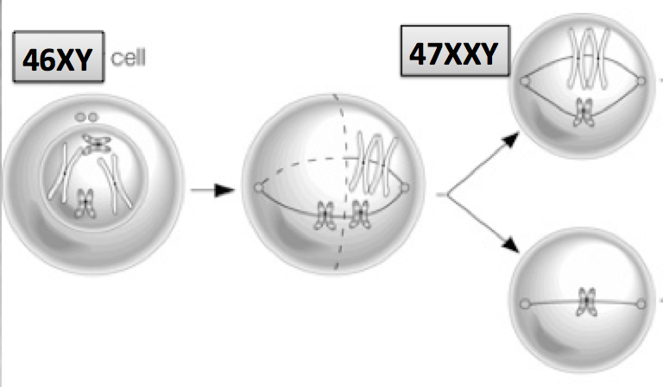
Nondisjunctions in Mitosis
3% of KS Non-disjunction

Slide 5
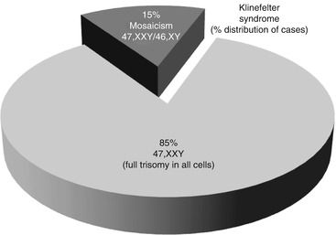
Mosaicism distribution in KS
Mosaicism (mainly 46,XY/47,XXY) is present in 10–20 % of the KS patients and arises from either non-disjunction in an early mitotic division of the developing 46,XY zygote, or from loss of one of the X chromosome of a 47,XXY conception due to anaphase lagging

Slide 6
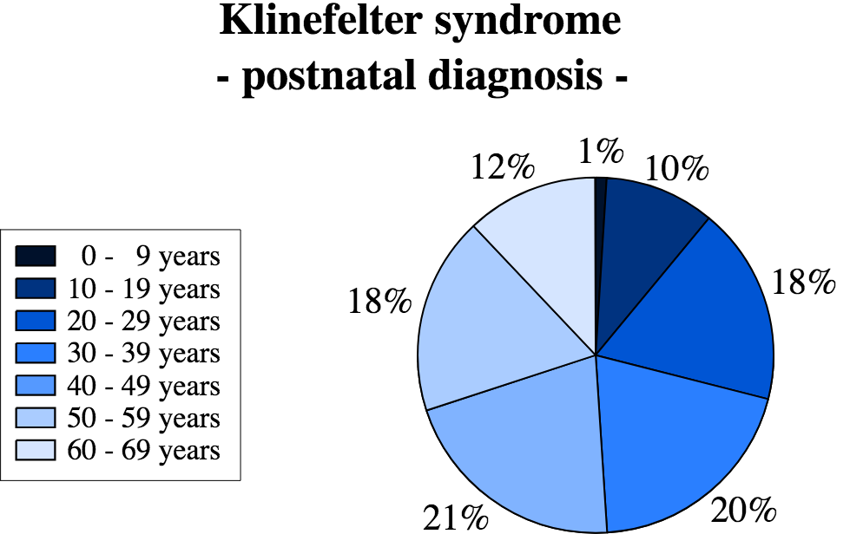
Incidence : 1 in 650 male newborn
Recent Australian : 1 in 448.
50-80% are not identified

Slide 7
Why it is difficult to diagnose all KS ?
50-80% are not identified
The difficulty in diagnosing KS, due to the heterogeneous phenotypic presentation and the lack of awareness of KS

Slide 9
Androgen Receptors
The androgen receptor (AR) gene, which mapped to
Xq11.2-12, is of physiological importance in the testis and
may play a particular role in differences of the KS phenotype
In KS men, one of the two AR alleles
is inactivated
KS men with longer CAG stretch present later onset and slower progression of puberty and slower testicular degeneration process

Slide 10
Factors affecting manifestations in KS
Degree of hypogonadism
CAG rpt polymorphism
Mosaicism
Random Skewe X inactivation
Epigenetics
????
PAR genes activity
Origin of extra X Chromosome

Slide 11
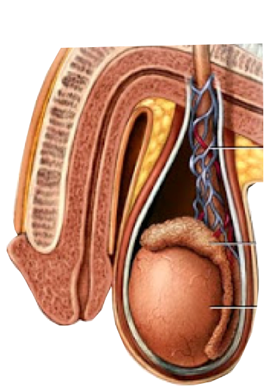
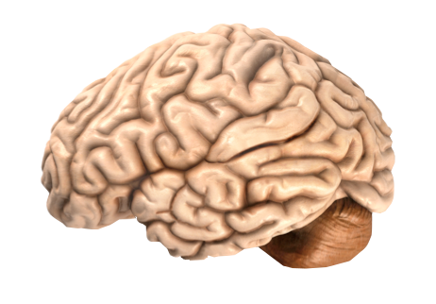
X Chromosome Functions
The X chromosome likely contains 800 to 900 genes that provide instructions for making proteins. These proteins perform a variety of different roles in the body
46XY
47XXY
Brain modeling Maturity
Language/Emotions
Behaviour/executive skills
Steroidogenesis
Spermatogenesis

Slide 12
Klinefelter Syndrome
Cardinal features
Associated comorbidities
Small firm testis
Tall stature
Azoospermia
Gynecomastia
Eunuchoid proportions
Sparse body and facial hair
Cardiovascular
Osteoporosis
Metabolic syndrome
Endocrine
DM
Infections
Auto immune SLE X14
Neurocognitive & Learning

Slide 13
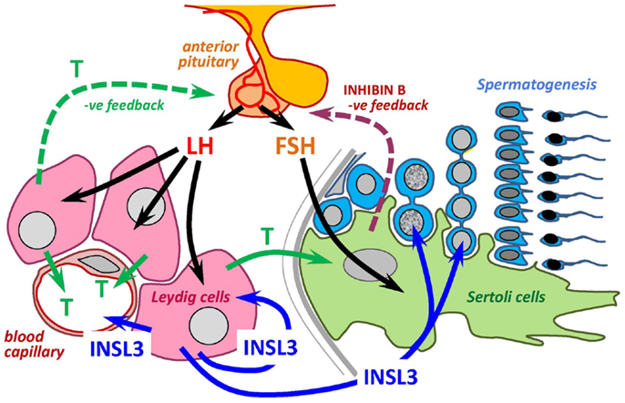
Hormonal control of spermatogenesis

Slide 14
Testosterone to Estrogen Ratio
A
A
E
T
T
E
46XY
47XXY

Slide 15
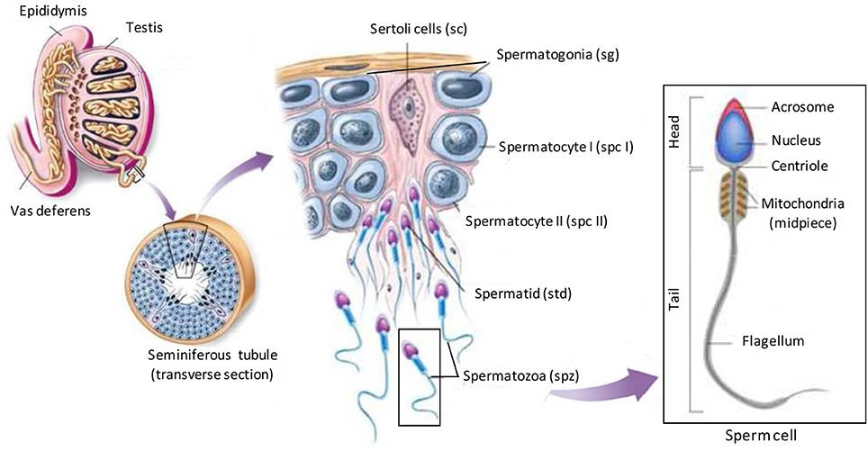
Spermatogenesis

Slide 16
Mechanism of Testicular Dysfunction in KS
Azoospermia in KS is the consequence of progressive germ cells degeneration starting from mid-puberty , a critical period in which also Sertoli cells (SCs) function impairs in association with an extensive fibrosis and hyalinization of the seminiferous tubules and hyperplasia of interstitium and Leydig cells (LCs)
The presence of an increased apoptosis affecting SCs and LCs has been proposed as a main mechanism leading to KS testis dysfunction . There is over-expression of several genes responsible of an increased apoptotic process.

Slide 17
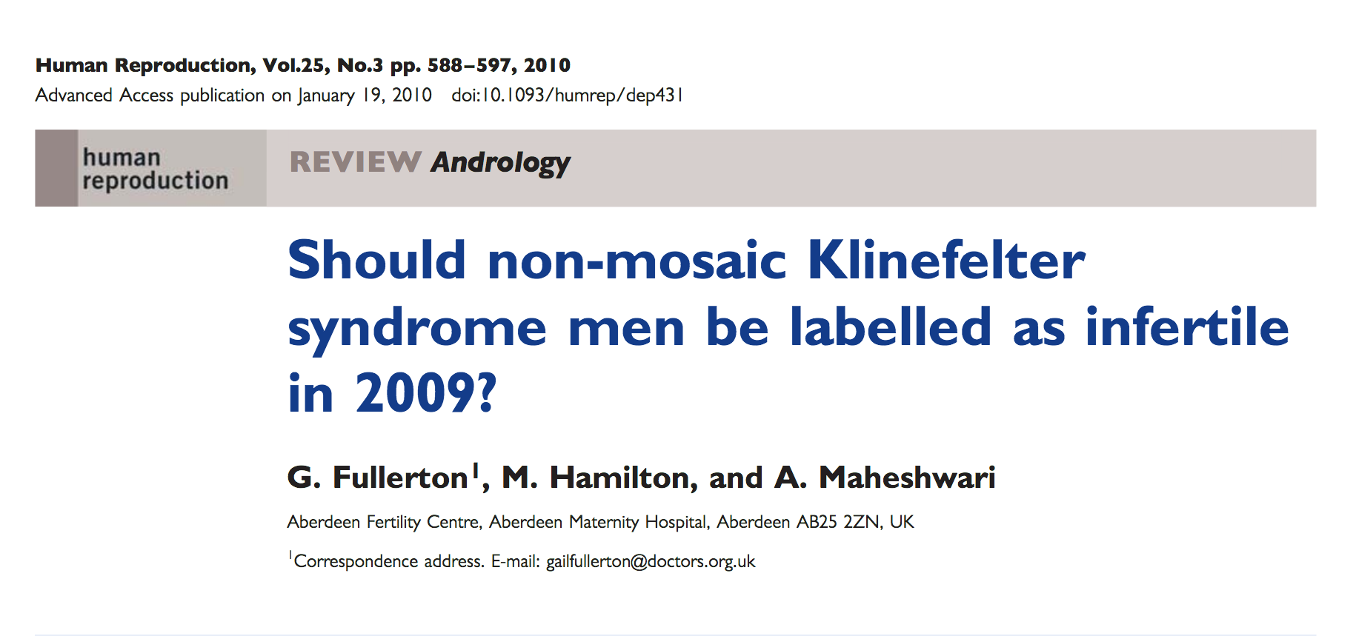
Concept change with KS fertility options

Slide 18
Fertility Options
Ejaculated Sperm
Sperm banking
MicroTESE
Stem cell therapy
Sperm donation
Adoption
According to a 2011 study by Maiburg et al., adults with KS were interested in fathering children and were willing to undergo testicular sperm extraction (TESE)

Slide 19
Ejaculated sperm in adults with KS
In literature, a few cases have been described where pregnancy was achieved during natural conception . or after Intra Cytoplasmic Sperm Injection (ICSI) using ejaculated sperm . The couple described by Crüger et al. actually had another child by ICSI a couple of years later. At each treatment, about six sperm cells were found in the ejaculate. KS men with sperm in the ejaculates may be suspected to have chromosomal mosaicism in the testicles or in general. In this first case describing paternity by natural conception in KS, there is no mentioning of how many peripheral leukocytes the diagnosis was based. Furthermore, the man with KS reported in this study, had testicular volumes of 10 mL, which is unusually large for a KS man . Therefore, it cannot be excluded that this man might have a KS mosaicism within the blood and/or inside the testis.
Ejaculated sperm were found in 11 of 131 8.4% of men with KS aged 18.6 to 34.8 yo

Slide 20
Fertility Options
Ejaculated Sperm
Sperm banking
MicroTESE
Stem cell therapy
Sperm donation
Adoption

Slide 21
Hormonal changes during Puberty
The average age of onset of puberty for boys is around 12-13 years
Testosterone level in an adolescent boy is very difficult to interpret.
It is often low, between 2 and 6 nmol/l, while perfectly normal pubertal progress and virilization is occurring.
In the absence of any pubertal change or where pubertal arrest occurs, testosterone levels are likely to be <0.5-2 nmol/l.
Inhibin B helps predict spermatogenesis.

Slide 22
Fertility Options
Ejaculated Sperm
Sperm banking
MicroTESE
Stem cell therapy
Sperm donation
Adoption

Slide 23
History of sperm retrieval and pregnancy in KS
With the development of new advanced assisted reproductive techniques such as TESE combined with ICSI it seems that KS patients should no longer be labeled as infertile.
In 1996 Successful recovery of spermatozoa by TESE in men with azoospermia and KS was reported for the first time, with the first pregnancies reported in 1997

Slide 24
Pre micro TESE preparation
A 3-6 months of anastrazole is generally prescribed if azoospermia is confirmed on semen analysis before sperm retrieval is considered.
Need to be off of T injections for 6-9 mos to be able to start making sperm again.
Repeat microTESE is not recommended
For maximum result MicroTESE need to be done in the IVF cycle

Slide 25
Predictors of sperm retrieval
Age < 30
Mosaicism
Testicular size
T level
T/E ratio
FSH & LH level
Prior use of TRT

Slide 26
Testosterone level and SRR
Treatment | T Level | SRR
No Treatment | Normal T | 86%
Treatment* | > 250 ng/dl (8.67 nmol/L) | 77%
Treatment | Low T | 63%
*Treatment : Anastrazole 1 mg/d followed by adding HCG if no response
Treatment is guided by T/E ratio.
Ramasamy et al J Urol 2009

Slide 27
Do we need to do PGT-A ?
Even if every cell in the body of a patient with KS has an extra chromosome, for some reason the sperm do not. The vast majority of sperm from KS patients, ejaculated or not, is normal X or Y sperm.

Slide 28
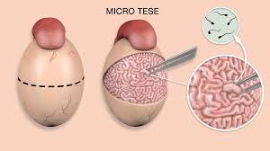
Technique of MicroTESE

Slide 29
MicroTESE in Klinefelter’s Syndrome
SRR is up to 70%

Slide 30
Outcome of TESE/ICSI in 47XXY
Based on analysis of 741 KS
Average 50 %
Conventional TESE 42%
MicroTESE 57%
At least 149 healthy live born babies have been born to without anomalies after ICSI for KS fathers

Slide 31
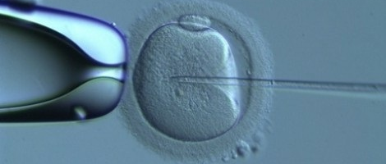
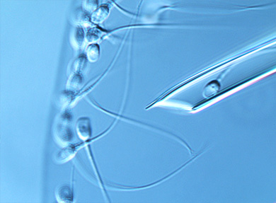
IntraCytoplasmic Sperm Injection ICSI
1st ICSI live born in 1992
ICSI revolutionized treatment of male infertility

Slide 32
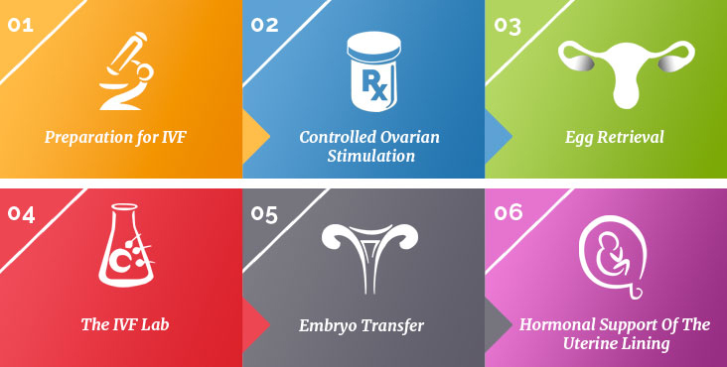
IVF Steps

Slide 33
Fertility Options
Ejaculated Sperm
Sperm banking
MicroTESE
Stem cell therapy
Sperm donation
Adoption

Slide 34
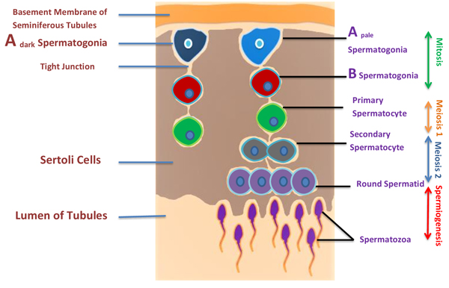
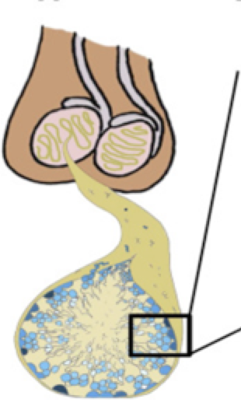
Spermatogonial stem cell Therapy

Slide 35
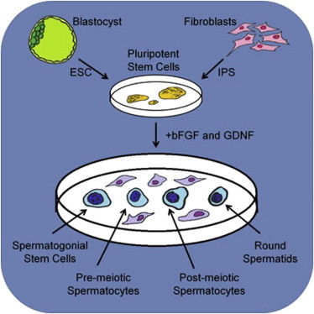
Spermatogonial stem cell Therapy

Slide 36
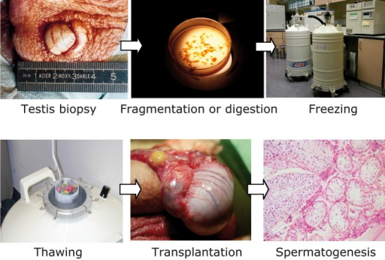
Spermatogonial stem cell Therapy

Slide 37
Fertility Options
Ejaculated Sperm
Sperm banking
MicroTESE
Stem cell therapy
Sperm donation
Adoption

Slide 38
Case Study
Mr PS 30 yo , seen in 2013 presented with primary infertility for y, and his SA showed Azospermia on 2 occasions. He had 2x Fine needle TxBx and no sperm found
After taking a detailed history and physical examination
testicular volume was 5 ml on each side.
Diagnosed of KS confirmed by karyotype, his FSH is 36 ,T level is 6.9
Partner AS 28 yo
PS was given Anastrozole 1mg/d for 3 months and
In 2014 wife underwent IVF
Open microTESE performed on the day of OPU.
Sperm was successfully retrieved and used for ICSI
10 Eggs collected and 5 fertilised and 4 embryos formed.
ETX2 conceived and delivered a girl.
In 2017 Thaw cycle ETX1 NP.
3/12 Later ETX1 Conceived and delivered their second daughter

Slide 39
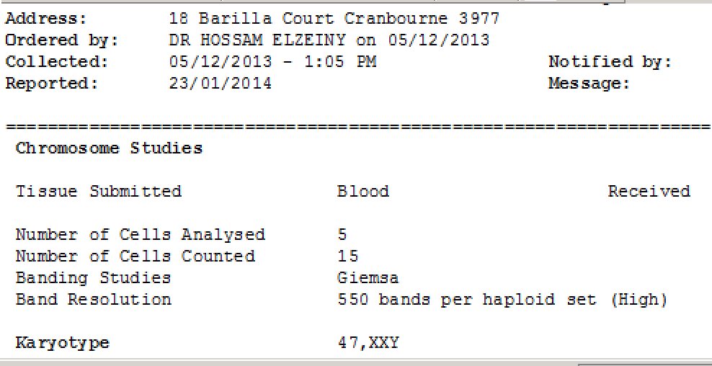

Slide 41
Thank you for your attention

